Slide 1

MEETING CONTRIBUTION
AUTO ANALYZER
Project Member
Pallavi Alanka
(20JG1A0502)
Mentor
G. Sankara Rao
Associate Professor
CSE Department
Department of Computer Science and Engineering
GAYATRI VIDYA PARISHAD COLLEGE OF ENGINEERING FOR WOMEN
[Approved by AICTE NEW DELHI, Affiliated to JNTUK Kakinada]
[Accredited by National Board of Accreditation(NBA) for B.Tech. CSE, ECE & IT – valid from 2019-22 and 2022-25]
[Accredited by National Assessment and Accreditation Council (NAAC) with A Grade – valid from 2022-27]
Kommadi, Madhurawada, Visakhapatnam – 530048
Academic Batch : 2020– 2024

Slide 2
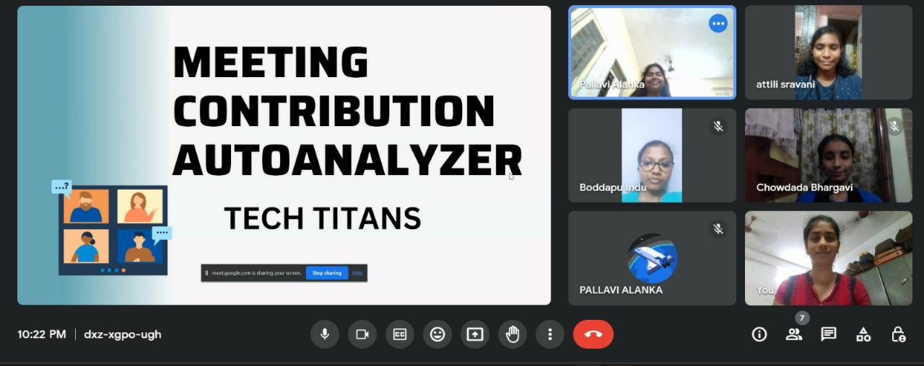

Slide 3
PRESENTATION OUTLINE:
About the Company
Abstract
Problem Statement
Objectives
Methodology – Roadmap
Tools and Modules Used
Implementations
Future Scope
References

Slide 4
About the Company:
DATAi2i is an AI & IOT company that specializes in helping businesses and industries leverage the power of data to optimize their operations, increase efficiency, and drive growth. Company’s cutting-edge solutions are designed to "Revolutionizing Industries through the Convergence of AI and IoT" through streamline processes, reduce costs, and improve overall performance, utilizing the latest AI-based analytics products, IoT hardware and software, and cloud-based services.

Slide 5
Abstract:
The "Meeting Contribution Auto Analyzer" is a cutting-edge project design to enhance the efficiency and productivity of business meetings through automated analysis of participants' contributions. In today's fast-paced corporate environment, effective collaboration is crucial for successful decision-making and project execution. It considers factors such as speaking time, engagement levels, and participation frequency.
Key features are: 1. Content Analysis
2. Participant Metrics

Slide 6

Problem Statement:
In today's fast-paced business environment, effective meetings play a crucial role in decision-making and driving organizational progress. However, it can be challenging for meeting organizers and stakeholders to assess the level of engagement and contributions from individual participants. Our problem is the absence of an automated contribution analyzer for meetings. Without such a tool, organizations face the following challenges:
Time-consuming Manual Analysis
Inefficient Progress Tracking

Slide 7
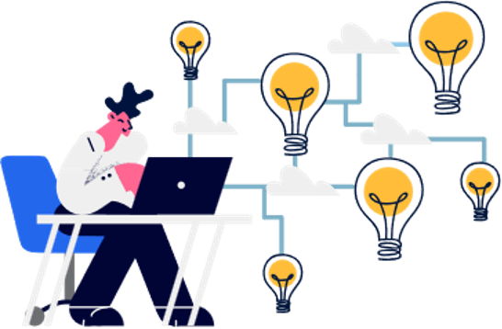
Objectives:
Develop an Automated Contribution Analyzer: The primary objective is to develop an automated tool that can analyse individual contributions during meetings
Reduce Time and Effort: By automating the analysis, the aim is to significantly reduce the time and effort currently spent on manual analysis.
Improve Accuracy: An automated tool could potentially offer more accurate and unbiased analysis compared to manual methods.
Enhance Progress Tracking: With accurate data on individual contributions, organizations would be better equipped to track progress on projects or initiatives discussed in meetings.

Slide 8
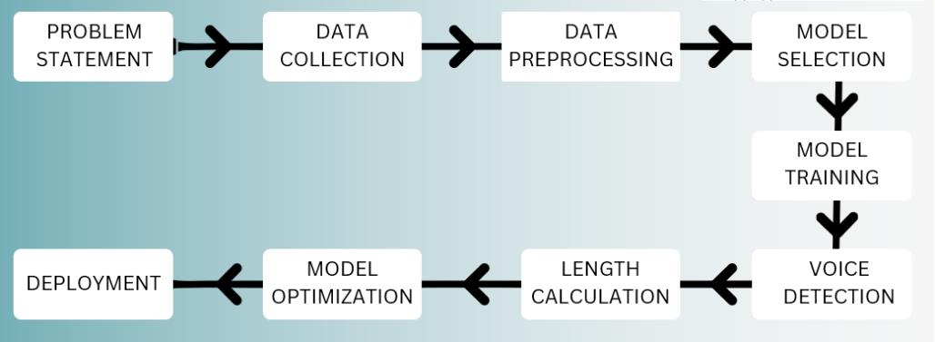
Roadmap of the project:

Slide 9

Tools and Modules Used:
We used different modules for
Audio Loading
Audio visualization
Feature extraction
Audio Manipulation
Conveting audio files into .wav and .mp3 files

Slide 10
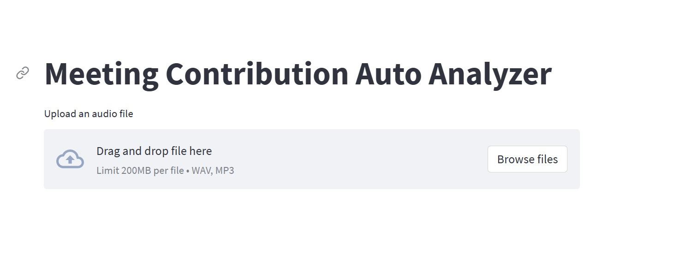
Implementations: Once after running the main file , you get to the following result:

Slide 11
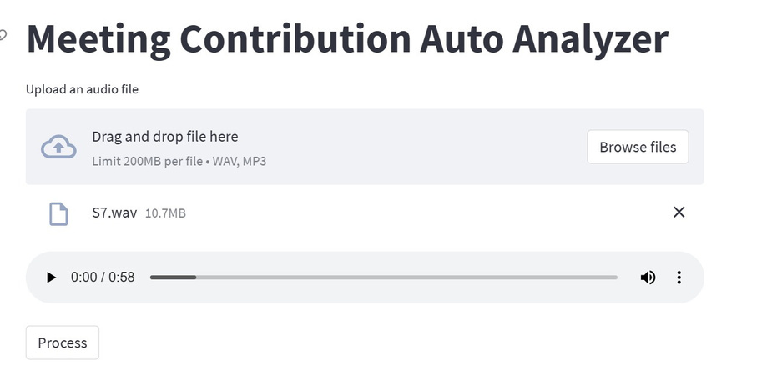
After dropping the audio files, click on the process button.

Slide 12
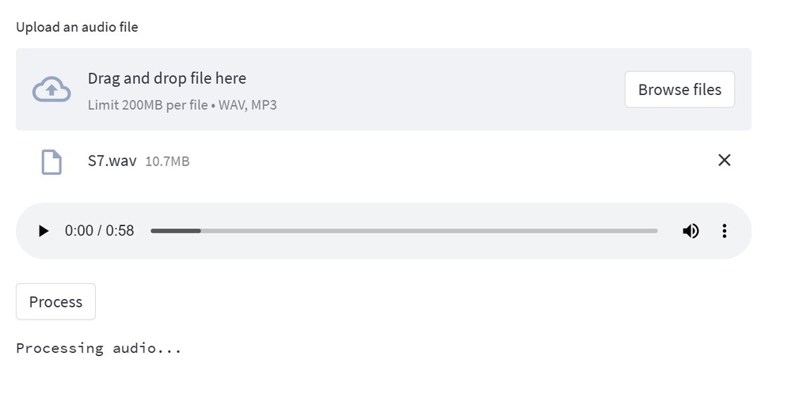
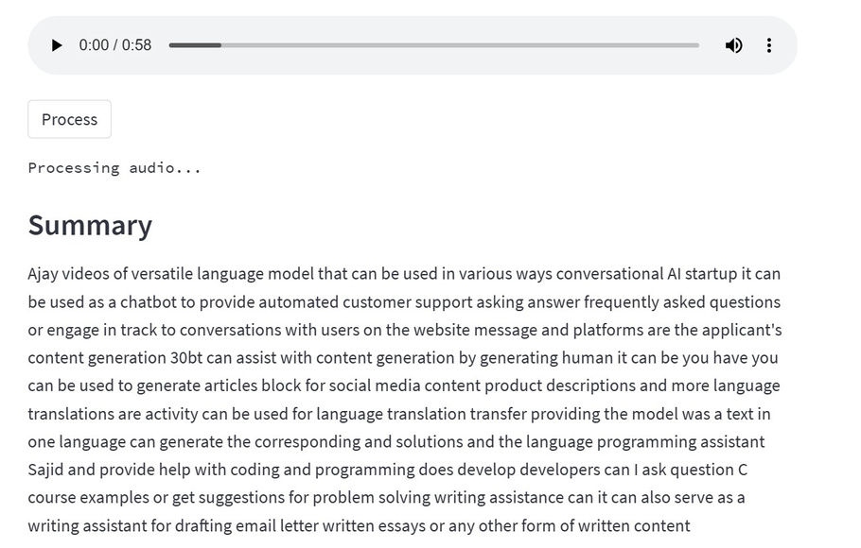
The results:

Slide 13
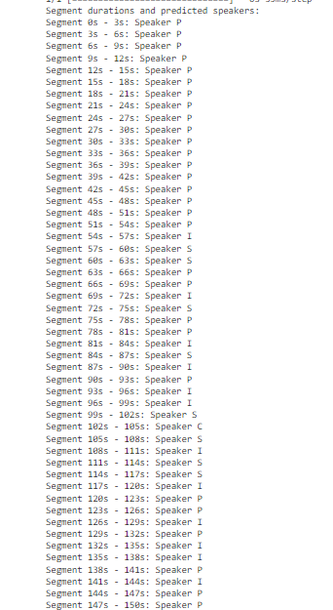
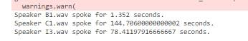

Model Results: Few results from the model

Slide 14
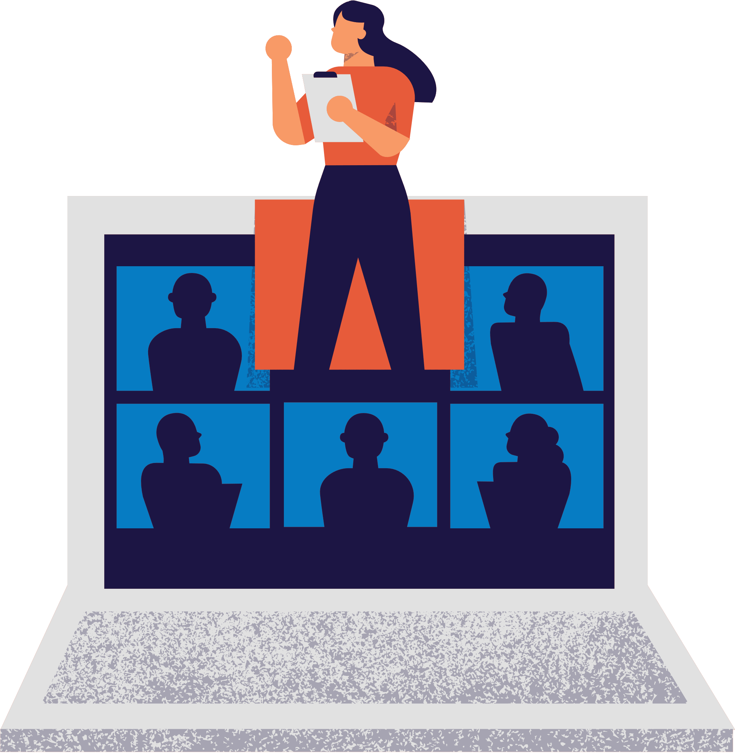

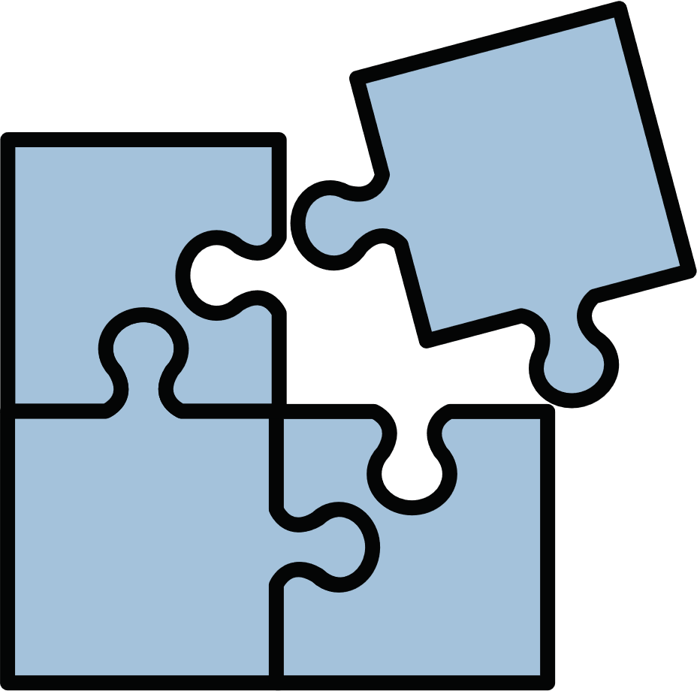
Future Scope:
Improved Accuracy: With advancements in AI and machine learning, the accuracy of speaker recognition and transcription can be further improved.
Real-Time Analysis: The system could be developed to provide real-time analysis during meetings, providing instant feedback and summaries.
Integration with Collaboration Tools: The system could be integrated with popular collaboration tools like Zoom, Microsoft Teams, and Google Meet, providing seamless meeting analysis within these platforms
Content Analysis: Future versions of the system could include more advanced content analysis, such as sentiment analysis, topic modelling.

Slide 15
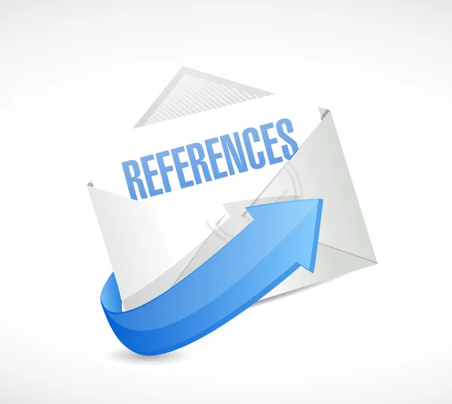
References I Used..
Video Summarization Using Deep Learning Techniques
Deep Learning Based Emotion Recognition
Audio-visual Speech Recognition Using Deep Learning
https://www.youtube.com/watch?v=SRRQCDZQ6G
Reference of project:
https://github.com/pallavee_0502/Meetingcontributanalyzer_Project

Slide 16
THANK YOU!
pallavialanka@gmail.com
https://www.linkedin.com/in/pallavi-alanka-a64327208

